Slide 1
Scala for Big Data: The Big Picture
Big Data / AZURE / AWS / Data Lakes
Anna-Maria Wykes
Data Engineering & Cloud Consultant

Slide 2

Who am I?
Senior Advancing Analytics Consultant specializing in Data Engineering & Cloud.
Over 14 years’ experience working in Software Engineering, most recently
working with Scala, Kafka and various cloud tech
I spent over 2 years working for a Microsoft Partner, championing a cutting-edge Data Science Project, aided by a variety of Azure tools, including Data Factory, Data Lake Gen2 and AKS.
I have a BSc in Multimedia Computing & Business, and a HND in Visual Communication
@annawykes
anna-maria-wykes-31939454

Slide 3
What makes me tick?
I have a passion for Data and strive to bring the worlds of Software Development and Data Science closer together.
I have helped to organize/run local Code Clubs
I help organize and volunteer at local events
Other areas of interest include UX, and Agile methodologies

Slide 4
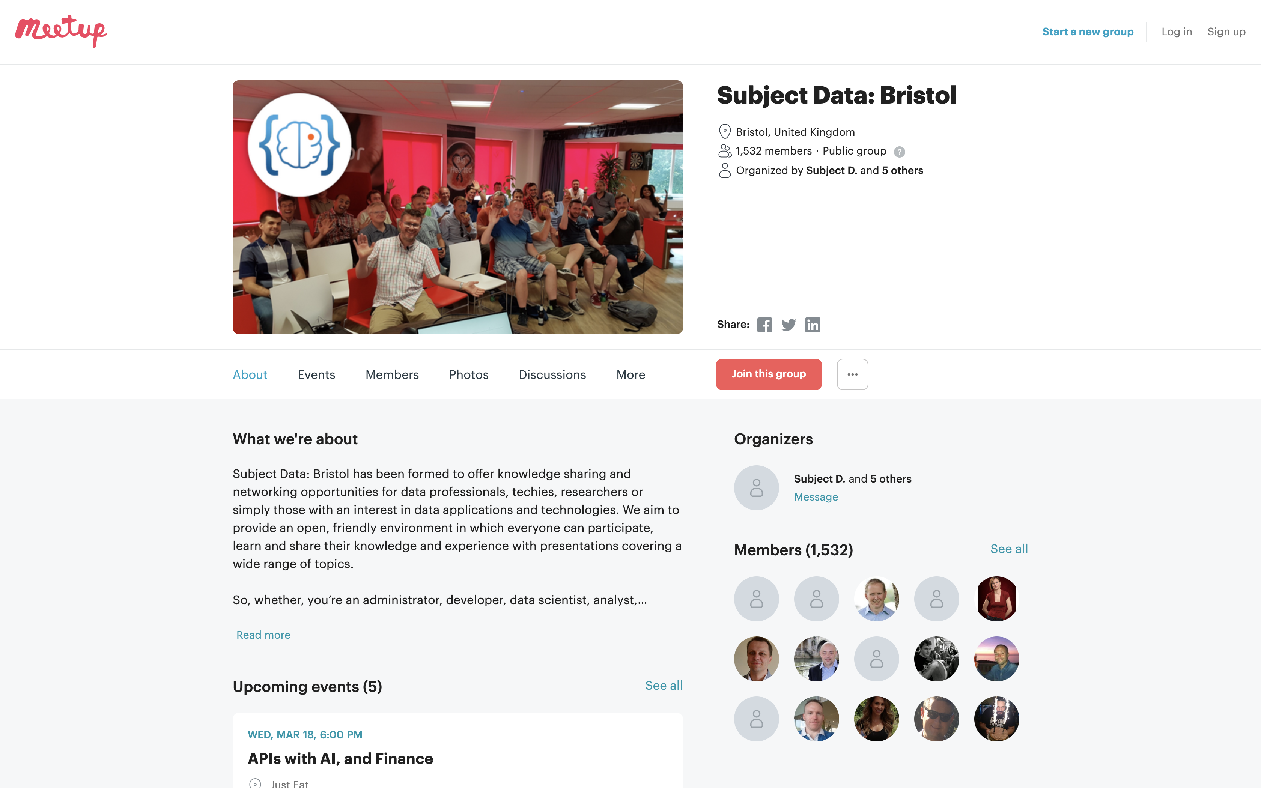
MEETups and Community Groups

Slide 5

Agenda: What are we going to do………
Refine data using Azure Data Bricks
Write JSON Data to Data Lake Gen2
Scala overview
Functional Programming
XML transformation to JSON
A BIT OF THEORY
PRACTICAL

Slide 6
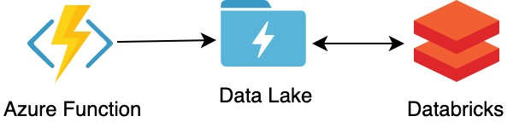
The (Real World) Problem
Third party API providing old school XML responses that need to be transformed into JSON and then:
Written to an Event Queue
2) Stored in Data Lake
https://github.com/AnnaWykes/scala-for-big-data

Slide 7

What is Scala?
Object Orientated and Functional programming paradigms
What is Scala used for? A lot of things, ranging from
Machine Learning to Web Apps
The name Scala stands for “scalable language.” The language is so named because it was designed to grow with the demands of its users

Slide 9
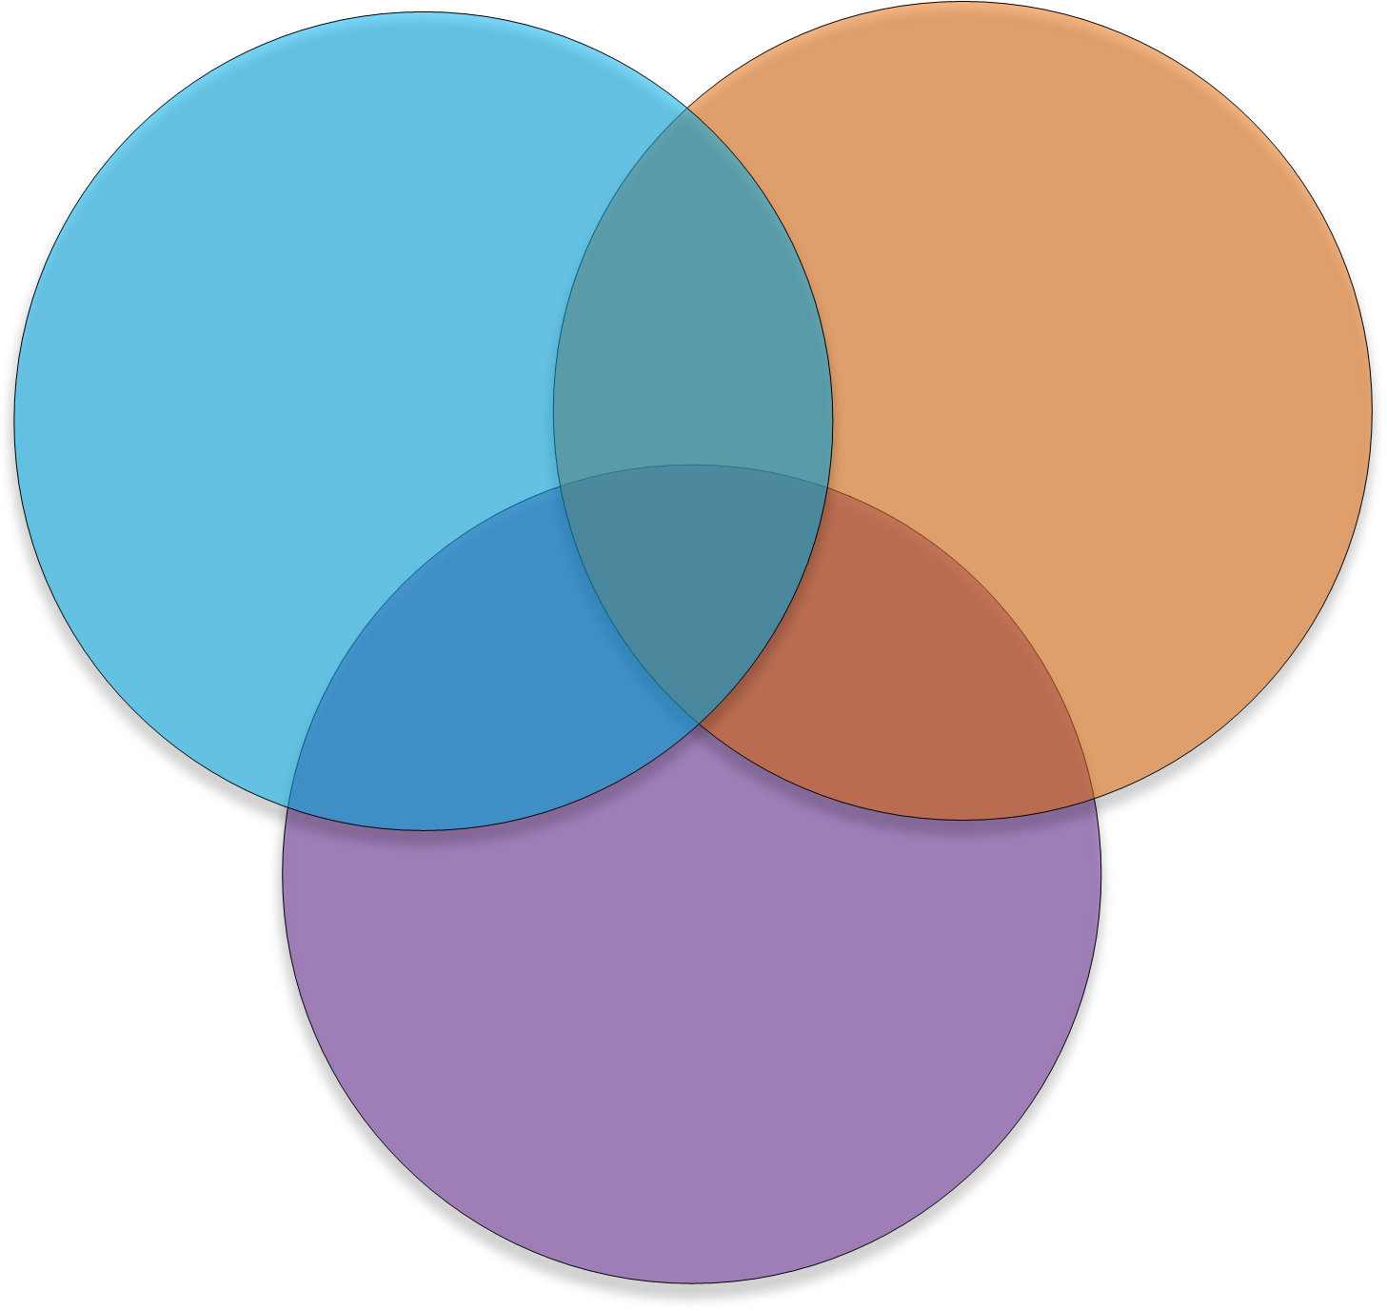
The ultimate teaching language?
Python
Java
Compilation
Procedural Programming
Static Types
OOP
Data Structures
Design Patterns
Interpreted
Dynamic Typing
REPL
C-Style
Functional Programming
JavaScript

Slide 10






Who Uses scala

Slide 11
Software written in scala

Slide 12
Scala and Big Fast Data
“Scala has taken over the world of “Fast” Data”
Which is what some are calling the next wave of computation engines that rely more on the speed of data processing rather than the size of the batch, and the ability to process event streams in real-time.
Several prominent examples of that movement are Spark, Scalding, Kafka (including Kafka Streams), and Samza, which are rapidly gaining awareness and use

Slide 13


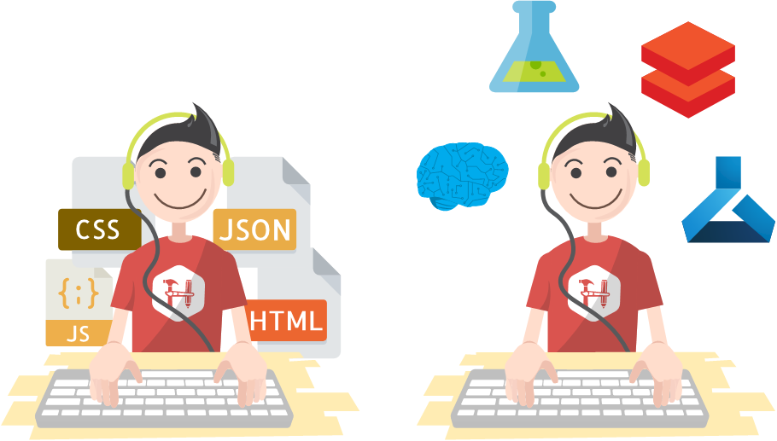
But still, why bother….
Notes:
Transferable, portable skills in their day job, Competitive skill set
Scala is multipurpose, meaning you can use if for anything from a simple web app to ML
It has a solid community behind it
It is Type safe
Learn Functional Programming

Slide 14
Type Safety
Type safety means that the compiler will validate types while compiling, and throw an error if you try to assign the wrong type to a variable

Slide 15
Types safety means you can’t turn a cat into a dog

Slide 16
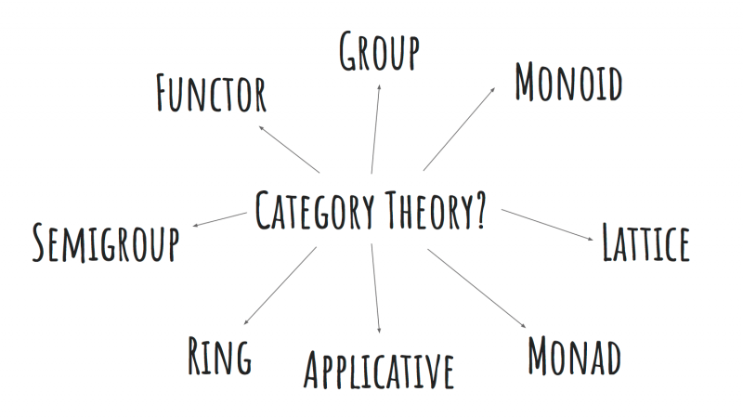
Functional Programming

Slide 17
Functional Programming: Monads
Step One
A Monad is a sequence of events with a get out of jail card
Step Two
Step Three

Slide 18
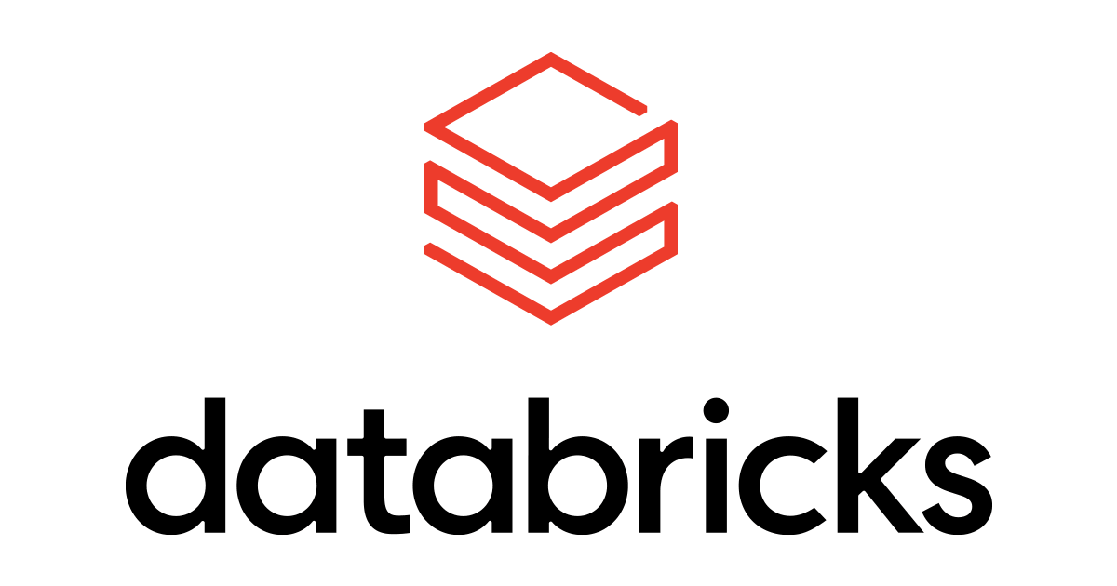


Slide 19
Apache Spark
Apache Spark is an open-source distributed general-purpose cluster-computing framework. Spark provides an interface for programming entire clusters with implicit data parallelism and fault tolerance

Slide 20

Databricks is an organization and big data processing platform founded by the creators of Apache Spark.
Databricks was founded to provide an alternative to the MapReduce system and provides a just-in-time cloud-based platform for big data processing clients.
Databricks was created for data scientists, engineers and analysts to help users integrate the fields of data science, engineering and the business behind them across the machine learning lifecycle. This integration helps to ease the processes from data preparation to experimentation and machine learning application deployment.

Slide 22
Basics of Scala What are we going to look at?
Case Classes
Option
Pattern matching
Map & FlatMap
Reduce and Filter
For Comprehensions

Slide 23
Case classes
Good for modelling immutable data Act like blueprints

Slide 24
Case classes

Slide 25
OPTIONS
Handles empty values without error

Slide 26
The NULL Mistake
“I call it my billion-dollar mistake. It was the invention of the null reference in 1965” — Tony Hoare, 2009

Slide 27
How does Scala handle Nulls: Options
A Scala Option holds zero or one element of a type. This means that it is either a Some[T] or a none object. One place we get an Option value is through the get() method for a Map
SOME = Something
NONE = Nothing

Slide 28
MAP
Opens the box of data and transforms it accordingly

Slide 30
FLATMAP
Opens the box of data, transforms it, and flattens it accordingly

Slide 31
When you forget to use flatmap

Slide 32
REDUCE AND FILTER
Sum everything up Only get the data you need

Slide 34
FOR COMPREHENSION
Monads

Slide 35
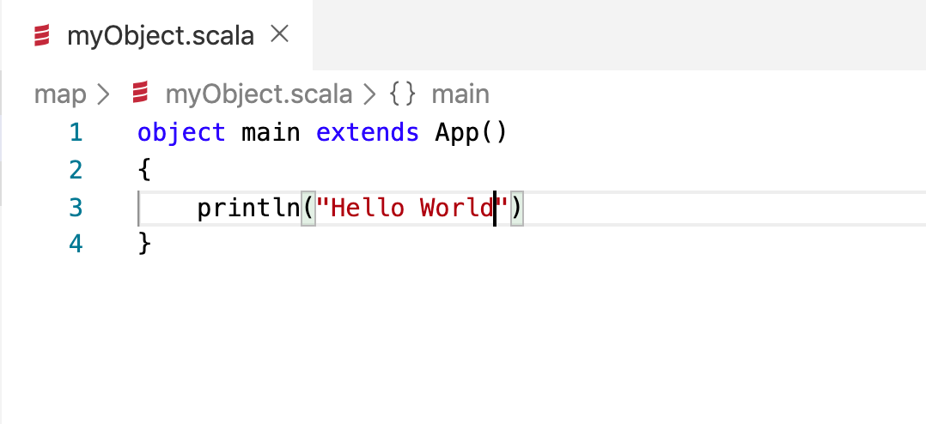
Objects
An object has exactly one instance (you can not call new MyObject). You can have multiple instances of a class.
Object serves the same (and some additional) purposes as the static methods and fields in Java/c#

Slide 36
DeMo Time: Azure Function TO TRANSFORM DATA
[JSON]
XML
Azure Function
Monad (Functional programming style)

Slide 37
Time to refine Our Data
Azure Function
Data Lake
Databricks
Move data from raw folder in Data Lake into refined folder

Slide 38
Useful links
Learning
https://www.scala-exercises.org/
https://scala.epfl.ch/
https://www.coursera.org/specializations/scala
https://typelevel.org/cats/
https://medium.com/disney-streaming/tagged/thisweekinscala
Conferences
https://scaladays.org/
https://scala.world/

Slide 39
THANK YOU
https://github.com/AnnaWykes/scala-for-big-data
anna-maria-wykes-31939454
@annawykes

